Slide 1
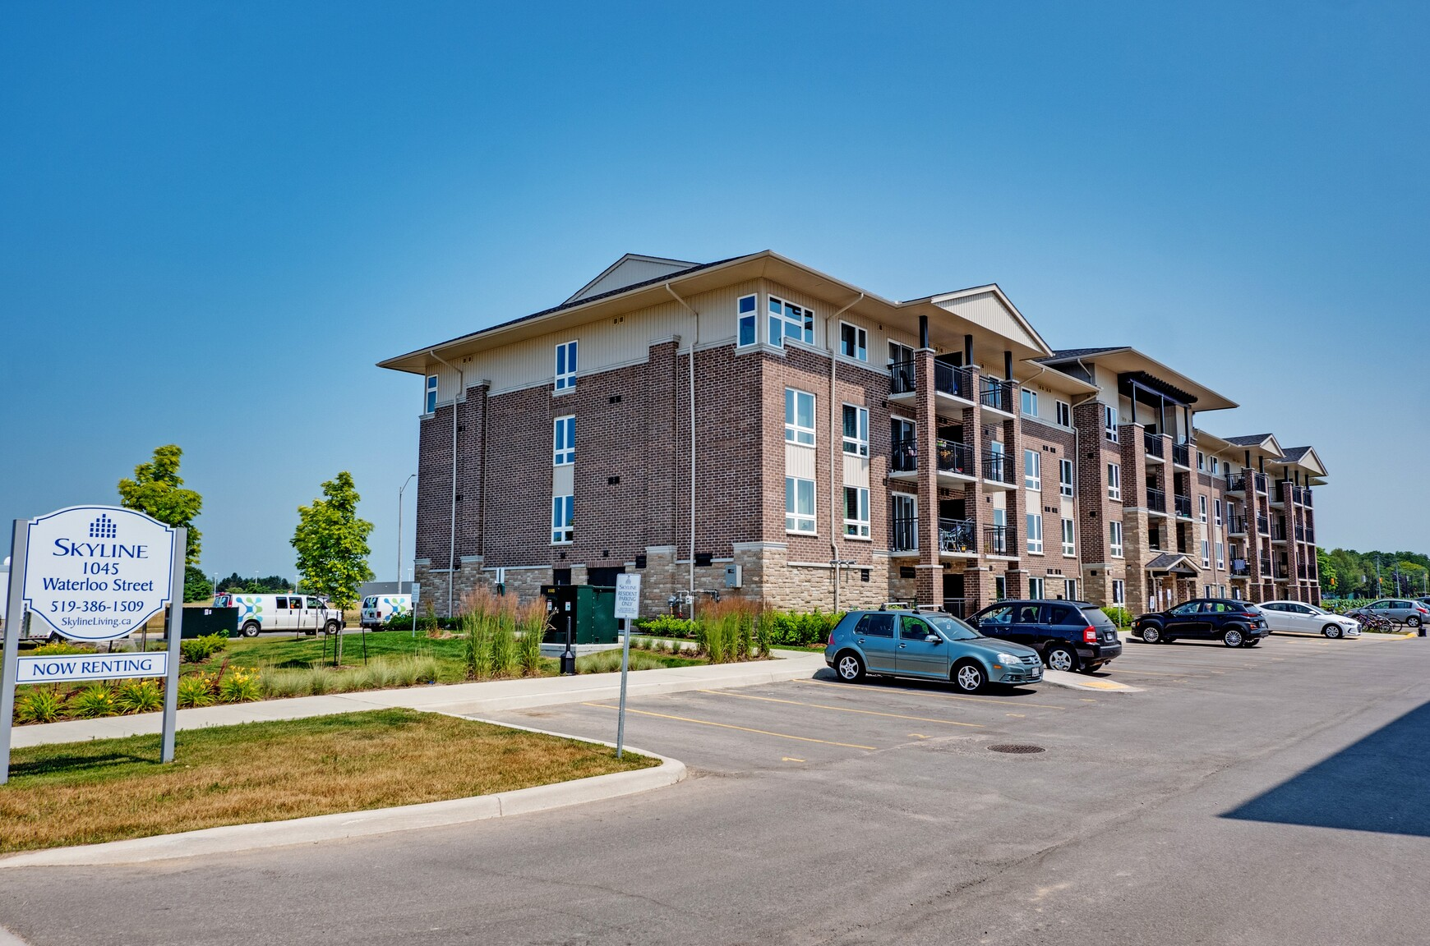

Town of Saugeen Shores
Proposed CIP Amendment and Guide Overview
Presentation
Statutory Public Meeting
May 19, 2026

Slide 2

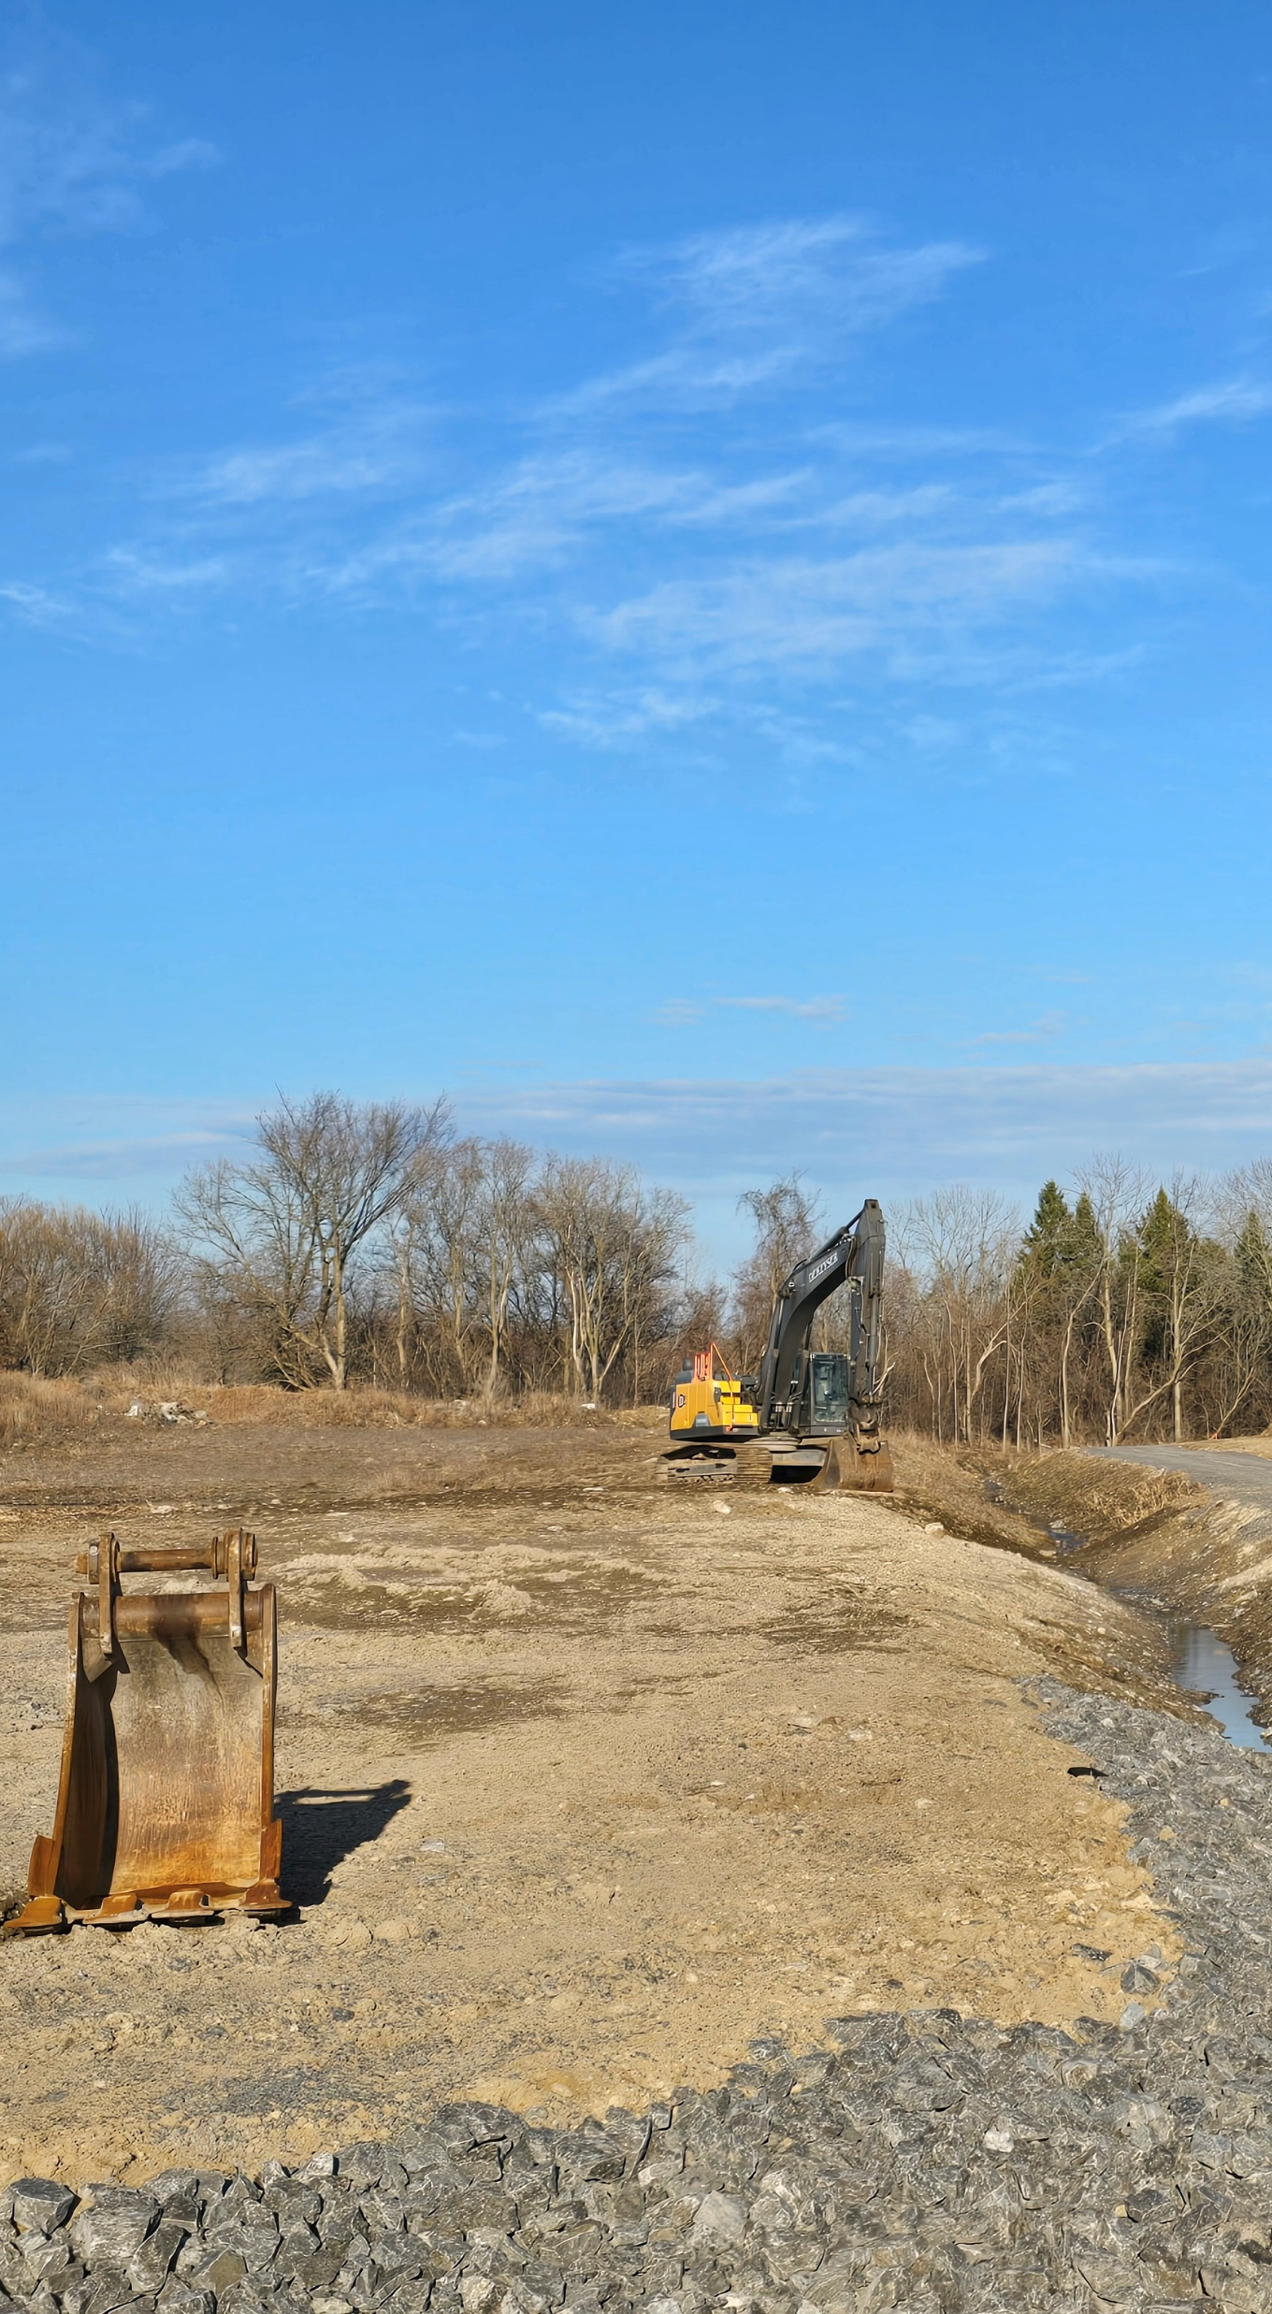
HOUSING-FOCUSED INCENTIVES
Key Objectives:
As a separately funded, time-limited supplement to the 2024 CIP, identify a range of targeted housing development supports.
Program support prioritized for rental and affordable rental housing development.
Additionally, support for a range of housing forms, and generalized support for affordable rental and affordable ownership housing.
The CIP:
Is aligned with County and Town housing strategies, legislative requirements, HAF funding, and best practices.
Provides a clear implementation roadmap for program delivery and monitoring.
2

Slide 3
CIP REVIEW PROCESS
Background Review
Stakeholder Engagement & Incentive Programs
Draft CIP
Final CIP
Sept – Nov 2025 Oct 2025 – Jan 2026 Feb – April May
Engagement Strategy
Policy & CIP Review
Best Practice Review
Market Analysis
Housing Working Group
Stakeholder Engagement
Confirm CIPA Boundaries
Preliminary Suite of Programs
Draft CIP document
Implementation Guidelines
County Consultation
Ministry Consultation
Final Draft CIP
Statutory Public Meeting with Council

Slide 4
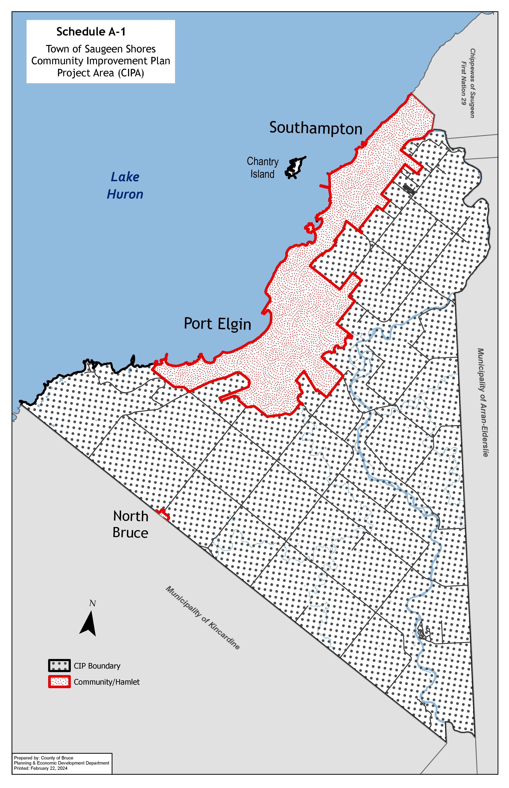
TOWN-WIDE CIPA
The existing CIP designates the entire municipality of the Town of Saugeen Shores as the Community Improvement Project Area (CIPA) with the downtown areas of Port Elgin and Southampton designated as priority project areas.
4

Slide 5
CIP RESERVE SUPPORTED BY HOUSING ACCELERATOR FUND (HAF)
Town’s Housing Accelerator Funding (HAF) includes:
  Funding allocated across 8 initiatives.
  $1.7 million allocated for incentive programs
  Spending sunset of December 4, 2028.
  Supplemental Housing Incentives terminate as of this date or until allocated funding is spent, whichever occurs first.

Slide 6
General Eligibility
Key limitations for applicability - all projects must:
Demonstrate alignment with the Town’s established housing goals, ensuring support for long-term community needs.
Applications for retroactive support, where work has already begun or been complete, will not be eligible.
Any work initiated after applying but before its approval is undertaken at the applicant’s own risk.
Financial incentives exclude Short-Term Rental Accommodation (STRA)

Slide 7
Affordable Housing
All AFFORDABLE UNITS:
Meet the CIP’s intent for Affordable housing needs and the CMHC definition of “affordable”.
For Purpose-Built Rental, requirement for affordability for a minimum of 25 years registered on title.
TIMING:
Applications for retroactive support, where work has already begun or been complete, will not be eligible.
Any work initiated after applying but before its approval is undertaken at the applicant’s own risk.
Financial incentives exclude Short-Term Rental Accommodation (STRA)

Slide 8
Program 1: Development Charge (DC) Grant
Description/ Goal: | To provide assistance for the development of Purpose-Built Rental Housing by further reducing the cost of development related to Development Charges (DCs).
Applicable Area | Serviced land within designated urban settlement areas in the Town that is zoned to allow residential uses.
Maximum Assistance | Grant is equivalent to a maximum of 50% of Development Charges levied by the Town or a maximum of $150,000 whichever is less.
Eligibility | Purpose built rental units arising from development, redevelopment or adaptive re-use of buildings.

Slide 9
Program 2: Additional Residential Unit (ARU) Grant
Description/ Goal: | To encourage the construction of a basement apartment, garden suite, upstairs apartment, or a living space within an existing secondary structure on a property by providing a grant to cover a portion of the capital construction costs.
Applicable Area | Serviced land within the Town that is zoned to allow residential uses.
Maximum Assistance | Grant funding for up to three ARUs (up to $30,000 total). Maximum assistance structured as follows: one (1) unit – $5,000; two (2) units – $7,500 per unit; and three (3) units – $10,000 per unit.
Eligibility | The primary dwelling unit on the property is owner-occupied. Eligible properties must be zoned to permit single detached, semi-detached, or rowhouse dwellings, as applicable to the form and location of the proposed ARUs, in accordance with the Development Charges Act, 1997.

Slide 10
Program 3: Affordable Missing Middle Grant
Description/ Goal: | To improve the financial viability of developing “missing middle” housing forms (semi-detached, duplexes, triplexes, fourplexes, townhouses, low-rise multi unit dwellings).
Applicable Area | Serviced land within designated urban settlement areas in the Town that is zoned to allow residential uses.
Maximum Assistance | Grant funding provided on a per unit basis to cover 100% of eligible costs, up to a maximum amount of $250,000 per project. Rental Unit at Affordable rate – up to $50,000 per unit. Ownership Unit at Affordable rate – up to $30,000 per unit.
Eligibility | Development includes a minimum of 3 units. New development, redevelopment, or conversion of properties that result in the creation of net new “missing middle” housing units.

Slide 11
Program 4: Municipal Fees Grant
Description/ Goal: | A reduction in applicable municipal fees, including planning and building permit fees. Reduced planning and building permit fees may, in concert with other program support, help encourage development efforts by reducing initial regulatory costs.
Applicable Area | Serviced land within designated urban settlement areas in the Town that is zoned to allow residential uses.
Maximum Assistance | Planning Application Fees Grant: Maximum grant of $5,000 per property or the cost of the combined eligible planning application fees, whichever is less. If affordable units are included, fees related to those units may be waived up to 100%. | Building Permit Fees Grant: Maximum grant of $30,000 per property or the cost of the combined eligible building permit fees, whichever is less. If affordable units are included, building permit fees related to those units may be waived up to 100%.
Eligibility | Program is limited to Purpose Built Rental and/or mixed-use development (rental units with commercial at grade).

Slide 12
Program 5: Municipal Property Acquisition and Disposition for Affordable Housing
Description/ Goal: | Building on the Town Affordable Housing on Town-owned Lands Policy, assistance to developers to develop Affordable Housing on surplus Town-owned lands at below market value through a Request for Proposal (RFP) process.
Applicable Area | Land within designated urban settlement areas in the Town that is zoned to allow residential uses. Properties located near essential services and employment hubs may be prioritized due to their strategic advantages.
Assistance | Lands sold below market value including either lands owned by the Town or land acquired by the Town and subsequently sold to non-profit developers below market value for the purpose of developing Affordable Housing. Non-profit housing developers may qualify for a low-cost purchase of surplus Town-owned land, subject to Council approval, via a Request for Proposal (RFP) process in which developers must present their proposals to the Town. Assistance only where the Town, at its sole discretion, pro-actively seeks to dispose of, or acquire, lands for Affordable Housing. There is no obligation on the part of the Town to utilize this program.
Eligibility | To safeguard the Town's commitment to affordability, any sale of Town-owned land will be conditional upon the development of LONG-TERM Affordable Housing on the site.

Slide 13
RELATIONSHIP BETWEEN PROGRAMS
There are 4 relevant programs (5th being a municipal land program) for considering the eligibility of a site/project in accessing each program.
Program 1 (DC-related grant) cannot be combined with Program 2 (ARUs). Note that all rental projects benefit from existing provisions for % reduction in the DC Act based on the number of bedrooms.
Affordable units (per the Province’s definition) is a high bar to meet (meaning low cost of rent or ownership) such that DC exemptions for affordable can only apply to these units.
A more workable definition for Affordable is that provided by CMHC which defines housing as "affordable" if it costs less than 30% of a household's before-tax income.
13

Slide 14
IMPLEMENTATION CONSIDERATIONS
Promotion and marketing of programs will be critical to CIP’s success and spending of HAF by Dec. 6, 2028.
Continuous application intake to enable greatest flexibility as projects arise.
Develop a Review/Evaluation staff team to evaluate applications.
14

Slide 15
Q & A

